Slide 1
AI Travel Planner for Students
CAPSTONE PROJECT
Presented By:
Parepalli Naga Venkata Sahithi
-Potti Sriramulu Chalavadi Mallikarjun Rao College of Engineering & Technology, CSE

Slide 2
OUTLINE
Problem Statement
System Development Approach
Algorithm & Deployment
Result
Conclusion
Future Scope(Optional)
References

Slide 3
Problem Statement
Students often face difficulties when planning trips due to:
Lack of time to research destinations
Limited budgets
No personalized travel suggestions
Difficulty managing itinerary, weather, and cost information
Problem: There is a need for an AI-based travel planner that helps students create smart, personalized, and budget-friendly itineraries by combining weather, location, and interest-based recommendations.

Slide 4
System Approach
Technologies Used:
Frontend: Streamlit (Python-based web UI)
AI Model: GPT-4o-mini (OpenAI API)
APIs Integrated:
OpenWeather API (live weather)
OpenCage API (location & coordinates)
Other Tools: dotenv (secure environment variables), pandas, requests
Description: The system uses Streamlit to collect user inputs (destination, dates, budget, interests). APIs fetch real-time weather and map data, and the AI model generates a personalized itinerary with packing lists, budgets, and travel tips.

Slide 5
Algorithm & Deployment
Algorithm (Step-by-Step):
Input trip details from the user.
Fetch location coordinates using OpenCage API.
Retrieve current weather using OpenWeather API.
Combine user data + weather + points of interest.
Generate AI itinerary using GPT-4o-mini model.
Display:
Day-wise plan
Budget breakdown
Smart packing list
Map visualization
Deployment:
Developed using Streamlit.
Deployed via Streamlit Cloud / GitHub.
.env file used for secure API key handling.

Slide 6
Result
✅ Generated AI Itinerary:
Day-wise plan (Morning, Afternoon, Evening)
Personalized budget division
Packing list based on weather
🗺️ Map View:
Displays points of interest near the destination
📥 Download Feature:
Option to download itinerary as a .txt file

Slide 7
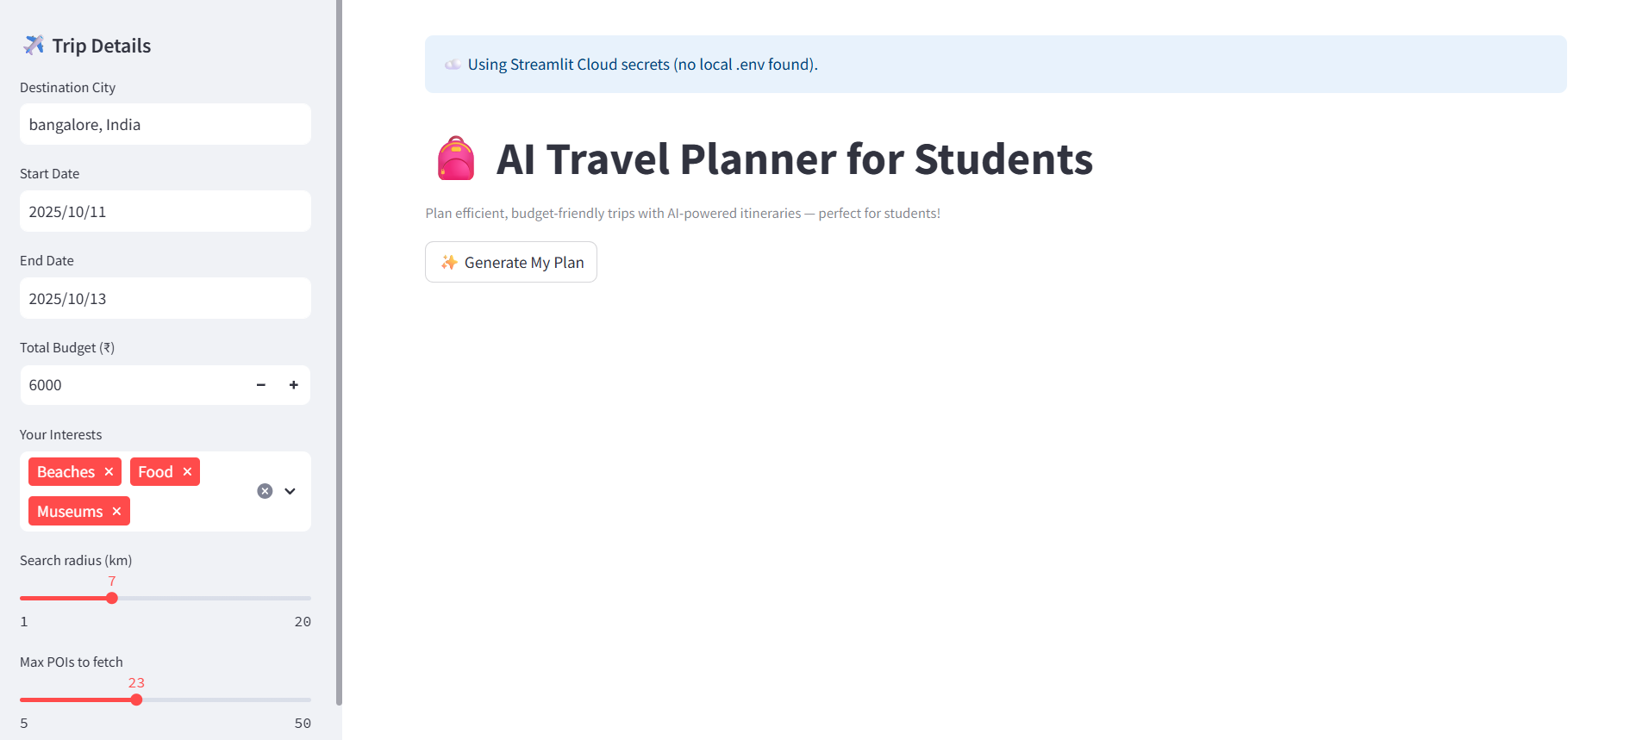
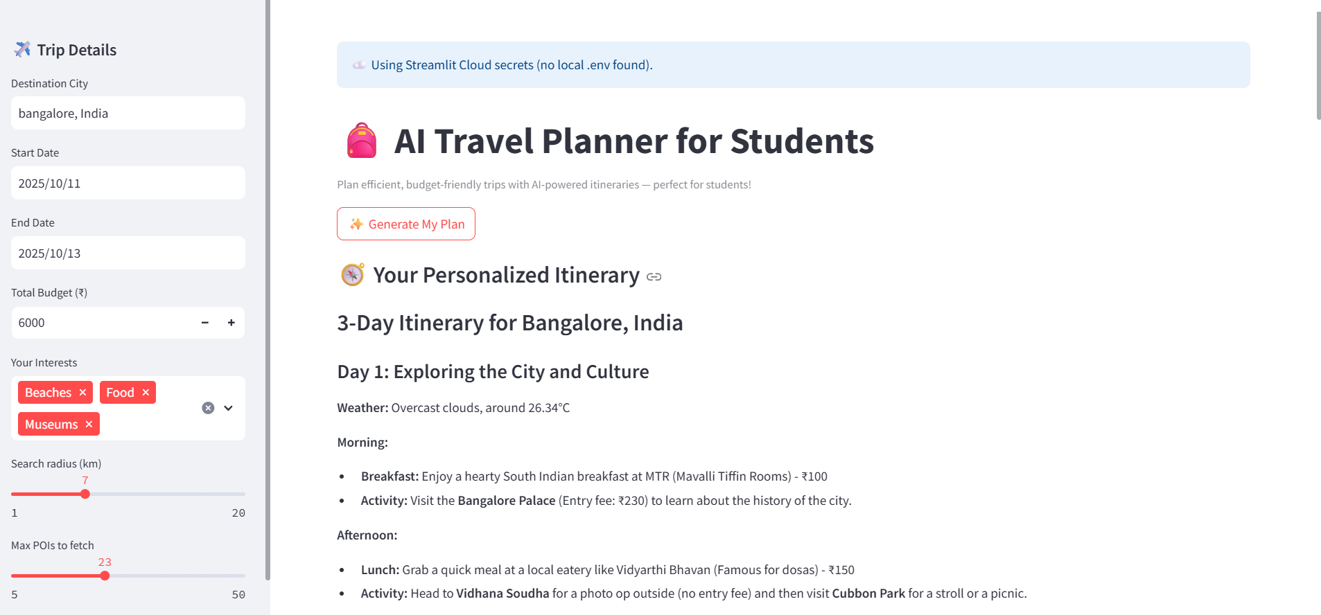
Result
Slide-1:
Slide-2:

Slide 8
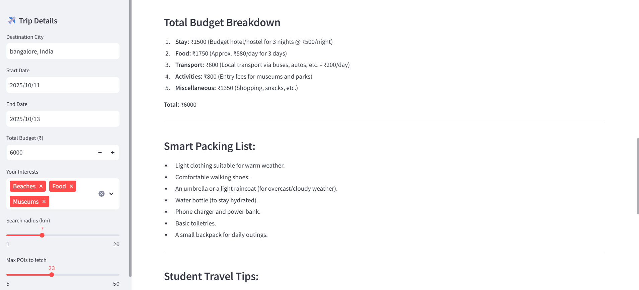
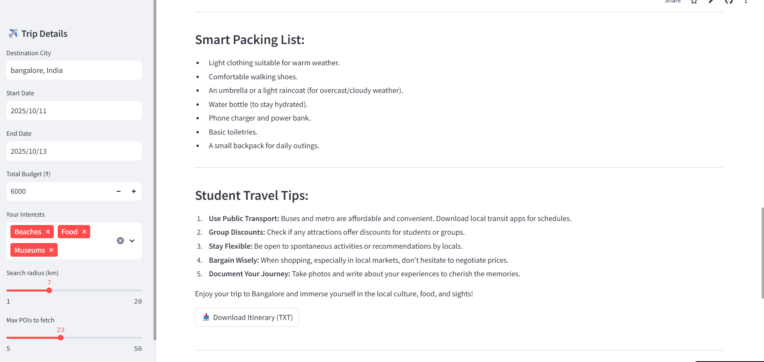
Result
Slide-3:
Slide-4:

Slide 9
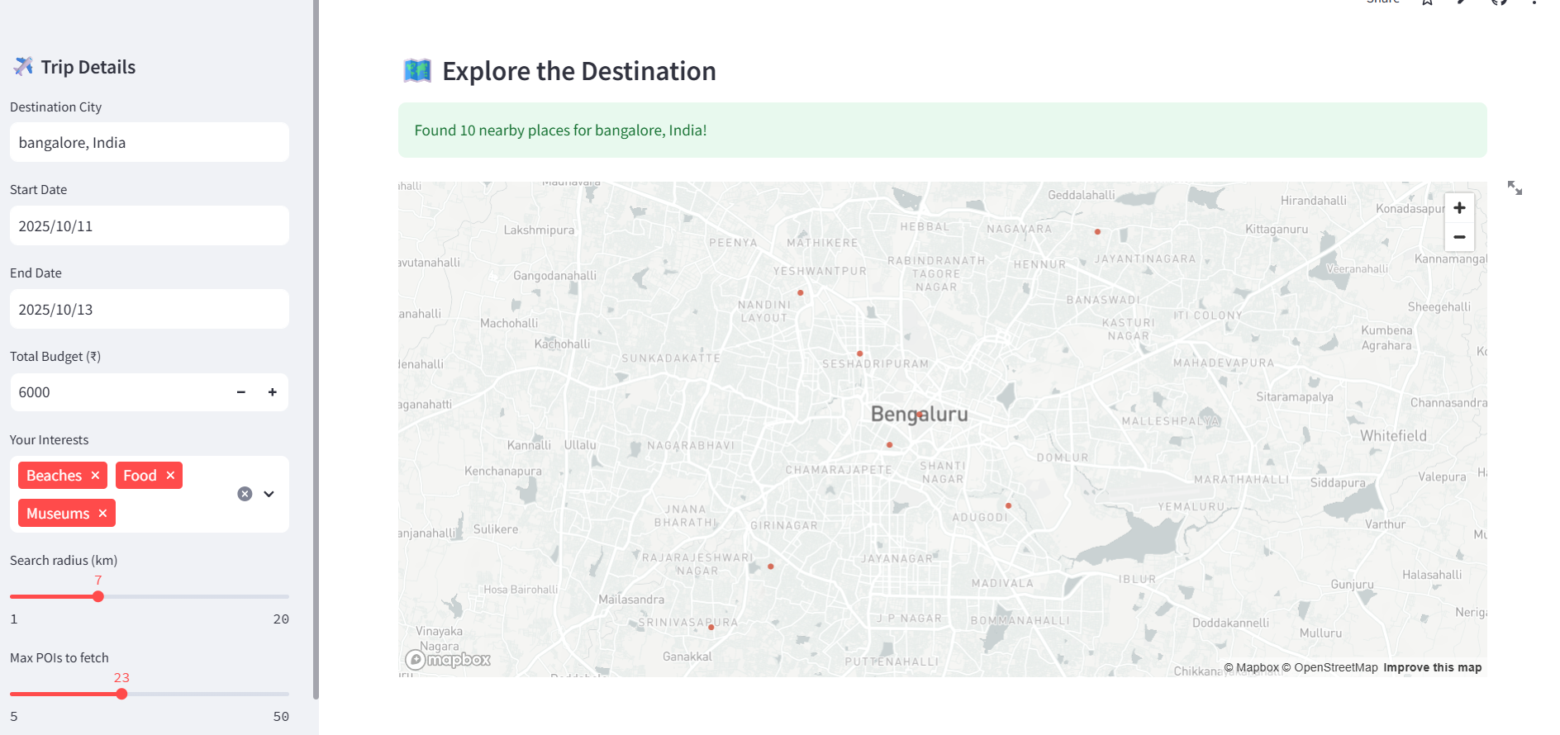
Result
Slide-5:

Slide 10
GITHUB AND DEPLOYMNET LINK
Attach your GitHub Link :
https://github.com/Parepallinagavenkatasahithi/AI-travel-planner.git
Deployment link:
https://ai-travel--planner.streamlit.app/

Slide 11
Conclusion
The AI Travel Planner helps students plan smarter and more efficient trips. By combining APIs and AI:
It personalizes travel experiences.
Saves time and cost.
Offers weather-based smart suggestions.
This project demonstrates how artificial intelligence can simplify daily planning and enhance travel accessibility for young travelers.
Overall, this solution bridges the gap between technology and travel, showing how AI-driven automation can make trip planning more efficient, affordable, and accessible — especially for students with limited budgets

Slide 12
Future scope
Add hotel & transport booking integration.
Introduce multi-destination route planning.
Include a voice assistant for trip queries.
Provide real-time currency conversion & alerts.
Use Google Maps API for live navigation.

Slide 13
References
OpenAI GPT-4o-mini–API Documentation
Streamlit Official Docs
OpenWeather API Documentation
OpenCage Geocoder API
Python Libraries: requests, pandas, dotenv

Slide 14
THANK YOU “Smart Trips. Simple Planning. Student-Friendly.”

